Slide 1



Natural Language Processing

Slide 2
Agenda
01
What is NLP?
02
Text Analytics
03
Sentiment Analysis

Slide 3
What is Natural Language Processing?

Slide 4
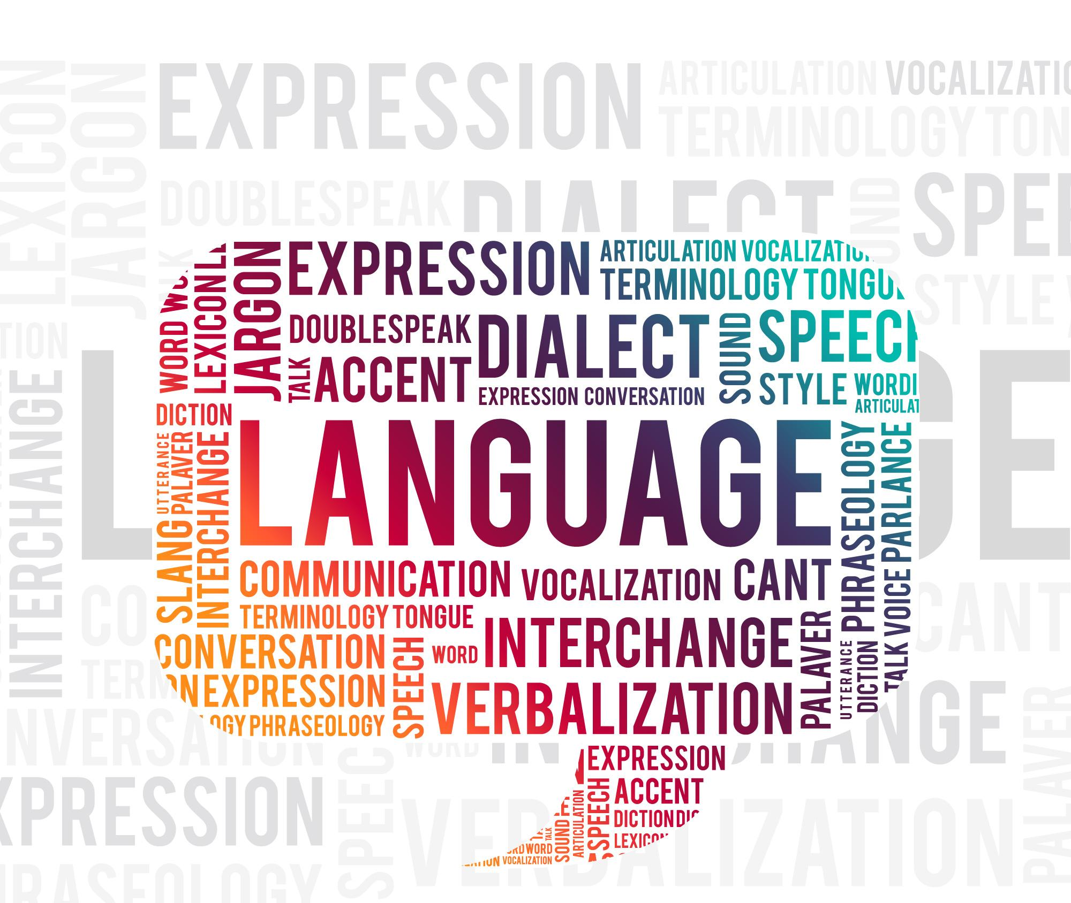
What is Natural Language Processing?
Natural language is how humans communicate, and with the generation of tons and tons of textual data. To analyze and process the data has become necessary for business outcomes.

Slide 5
Text Analytics

Slide 6
Text Analytics
Lexical Normalization
Tokenization
01
03
Stopwords
POS Tagging
02
04

Slide 7
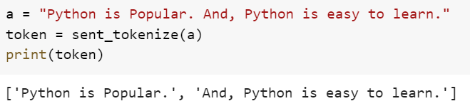
Text Analytics
Tokenization is the process of breaking down the text into small tokens.
The processing time increases with tokenization and helps in faster computation of text analytics.
Tokenization
01

Slide 8
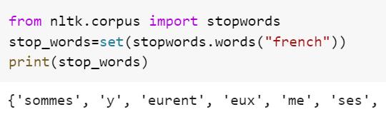
Text Analytics
Stop words are the noise in the textual data, that must be removed from the data.
Stopwords
02

Slide 9
Text Analytics
Lexical normalization is breaking down the tokens into their base forms, There are two types of lexical normalization – Stemming and Lemmatization.
Lexical Normalization
03

Slide 10
Text Analytics
Lexical Normalization
Stemming
03
Stemming is a linguistic normalization procedure in which the word or the token is reduced to its root word and removes the derivational affixes.

Slide 11
Text Analytics
Lexical Normalization
Lemmatization
03
Lemmatization reduces words to their base word, which is linguistically correct lemmas. It transforms root word with the use of vocabulary and morphological analysis. For Example – Flying becomes fly.

Slide 12
Text Analytics
POS tagging or the Part of Speech tagging is identifying the grammatical group for the given word. Like a noun, pronoun, etc.
POS Tagging
04

Slide 13
Sentiment Analysis

Slide 14

Sentiment Analysis
Sentiment Analysis is the predictive modeling technique in which a model is trained on sentiment labels, often generated by NLTK functions and then are used to predict the sentiments associated with the texts.

Slide 15
Sentiment Analysis
Text Data
01
Feature Engineering
03
Sentiment
Analysis
05
Tokenization, Removing Stop Words
Model Building
04
02

Slide 16
Sentiment Analysis
The sentiment analysis lifecycle starts from gathering the textual data and transforming the data removing the outliers and null values before the further computation.
Text Data
01

Slide 17
Sentiment Analysis
Tokenization is initially done to simplify the computation, and stop words are removed to remove the noise from the data.
Tokenization, Removing Stop Words
02

Slide 18
Sentiment Analysis
Feature Engineering
Feature engineering is done on the textual data by Bag-of-words and TF-IFD, that can be used to train the model.
03

Slide 19
Sentiment Analysis
After the feature engineering has been finished, the model is trained on the transformed data, and we can use them to predict the sentiments on the test sets/validation sets, and unseen data as well.
Model Building
04

Slide 20
Sentiment Analysis
Sentiment
Analysis
For data, that may not have labels, we generate the sentiments associated with the texts based on the intensity using NLTK, and train the model with the exact same approach as we train any other model.
05

